Slide 1
Road Accident Analytics using Tableu
GROUP 4

Slide 2
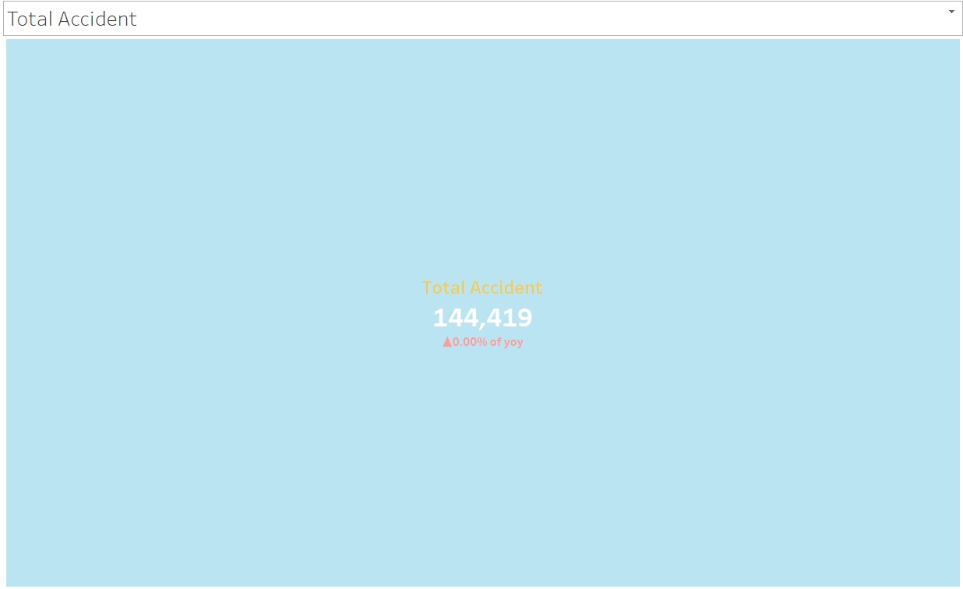
Total Accidents KPI

Slide 3
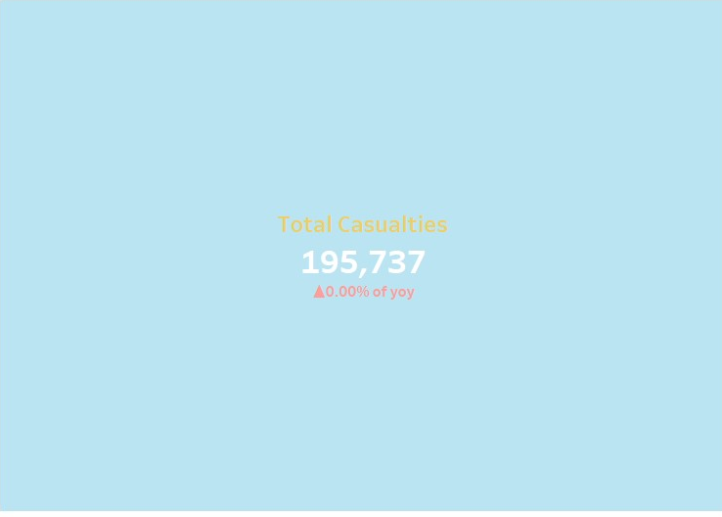
Total Casualaties KPI

Slide 4
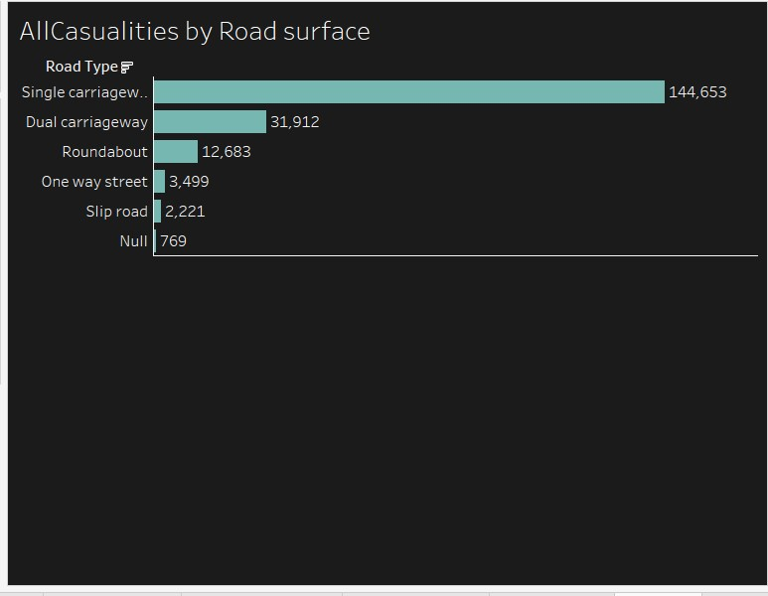
Accident Casualties Shown by Bargraph

Slide 5
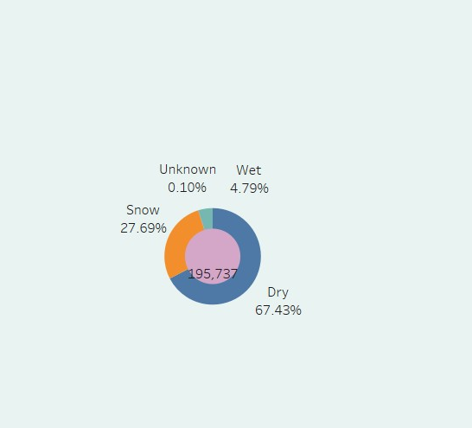
Accidents caused By different wheteher,Donut chart

Slide 6
